Slide 1
Bachelor Project Irrigation Machine Learning
Adrien Chabert

Slide 2

Motivation
To predict water quantity necessary for a specific plant for it to remain in its confort zone

Slide 3
Motivation
200’000 km³ of fresh water on earth
Nearly 2/3 are used for irrigation
With intelligent irrigation, we can decrease water consumption of 20%-25%

Slide 4

Plan of the Project
Research of Literature
Collect Data
Implementation of Machine Learning Algorithm
Test our result
Create a watering plan

Slide 5

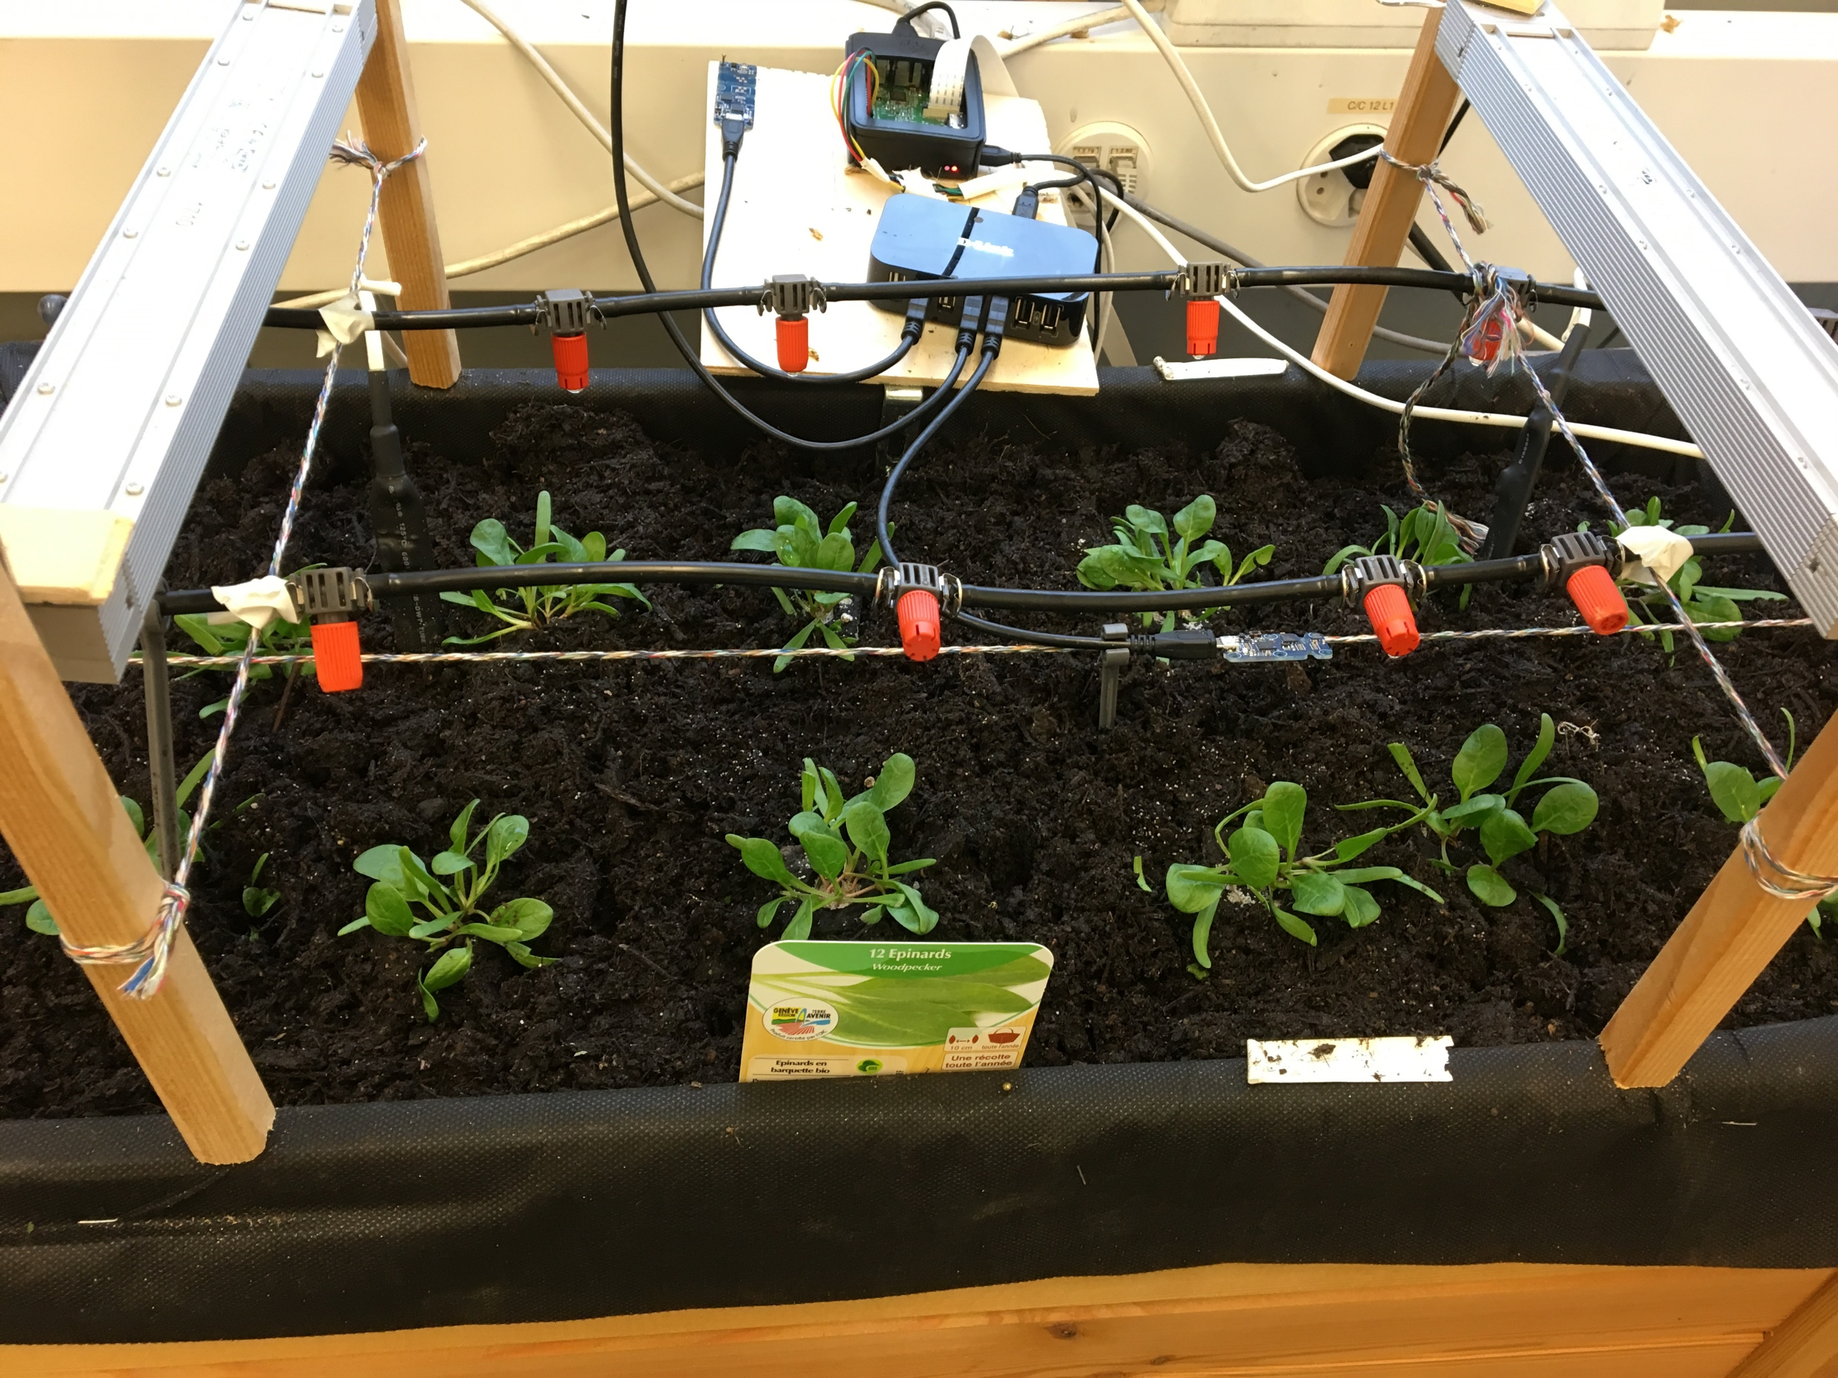
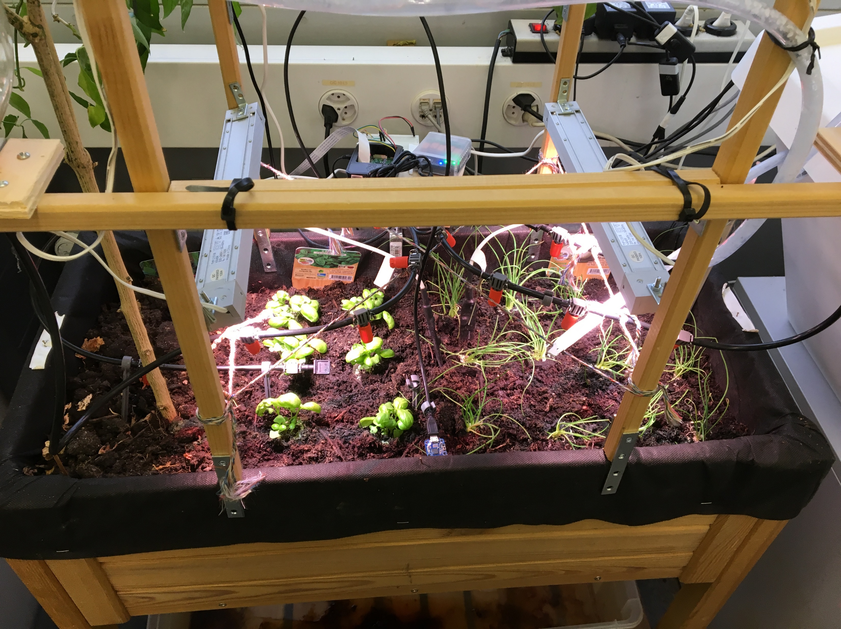
Planting
Basilic, onion, spinach

Slide 6
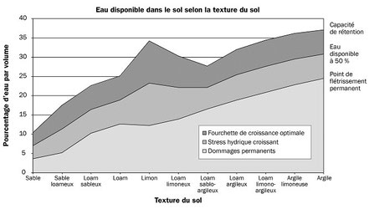
Optimal soil Moisture depending of the soil
Source : https://www.capteurs-et-mesures-agralis.com/mesure-humidite-sol/

Slide 7




Installation and understanding of the different programs

Slide 8




Impact soil moisture
Temperature
Wind
sunshine
Air moisture
Plant’s growth

Slide 9
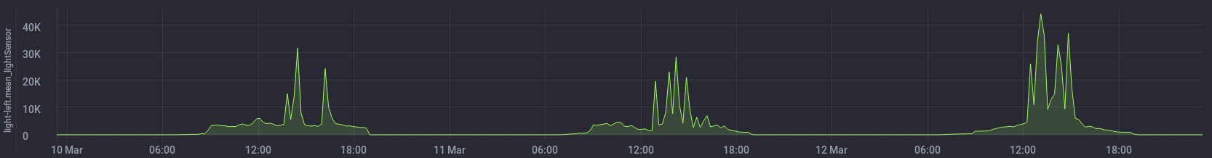
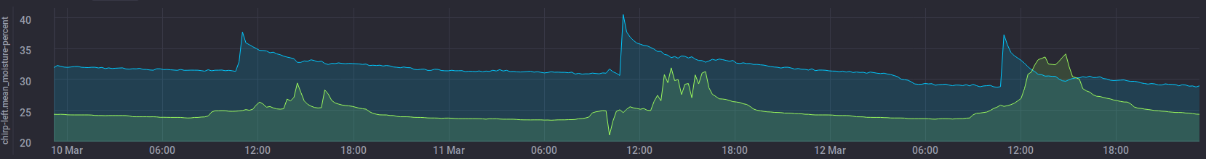
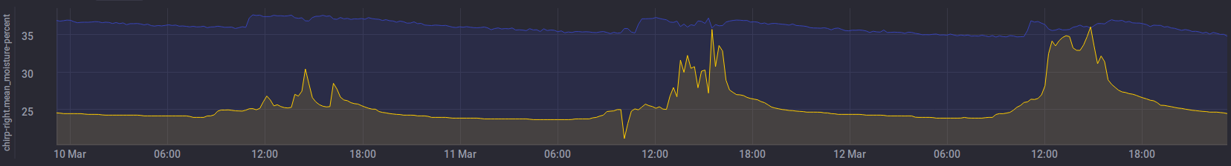
Result Analyse
Demeter.autogen chirp-left : Moisture percent and temperature
Demeter.autogen chirp-right : Moisture percent and temperature

Slide 10
Encountered problem
Position of the humidity sensor
Weird curve
Not found comparable experience in indoor small scale

Slide 11
Planning for the next 3 weeks
End of the research of Literature
Research about Machine Learning algorithm
Implementation of a first easy ML algorithm
Bayesian learning machine approach for Regression
Least Squares Multiple Linear Regression
Vary the watering with respect of the plants

Slide 12
Project Planning

